Slide 1
Python Server-side Programming
Lists & Functions

Slide 2

Academic skill center needs Peer Tutors
Paid position to provide tutoring services
Assist first year students just starting out
Gain valuable skills you can put on your CV
https://www.dawsoncollege.qc.ca/academic-skills-centre/

Slide 3
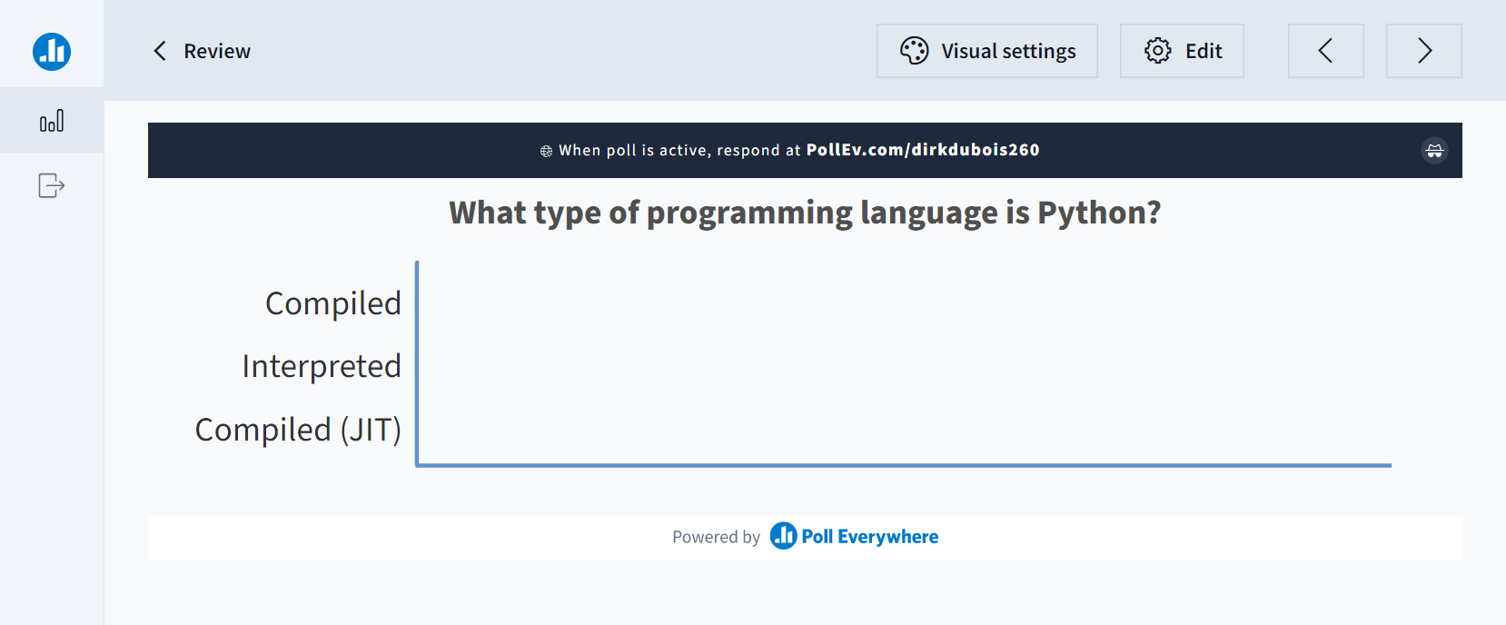
Let’s review

Slide 4
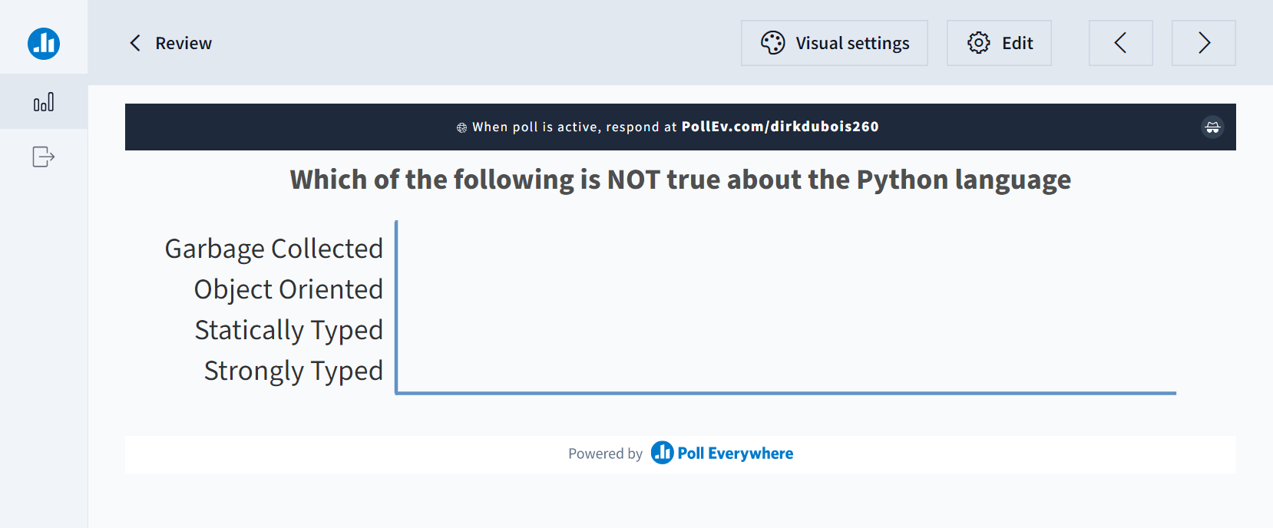
Let’s review

Slide 5
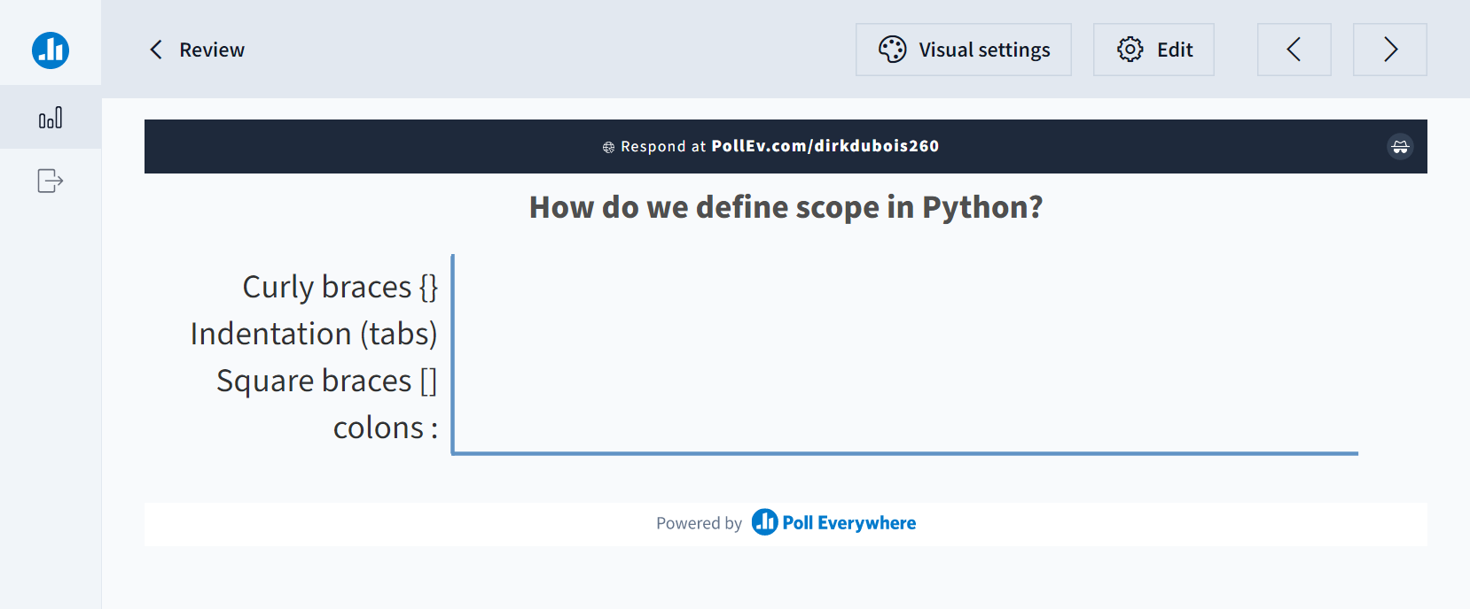
Let’s review

Slide 6
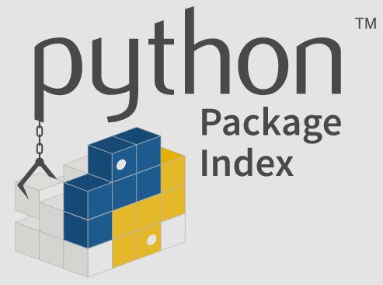
Python Packages and Libraries
A brief aside

Slide 7
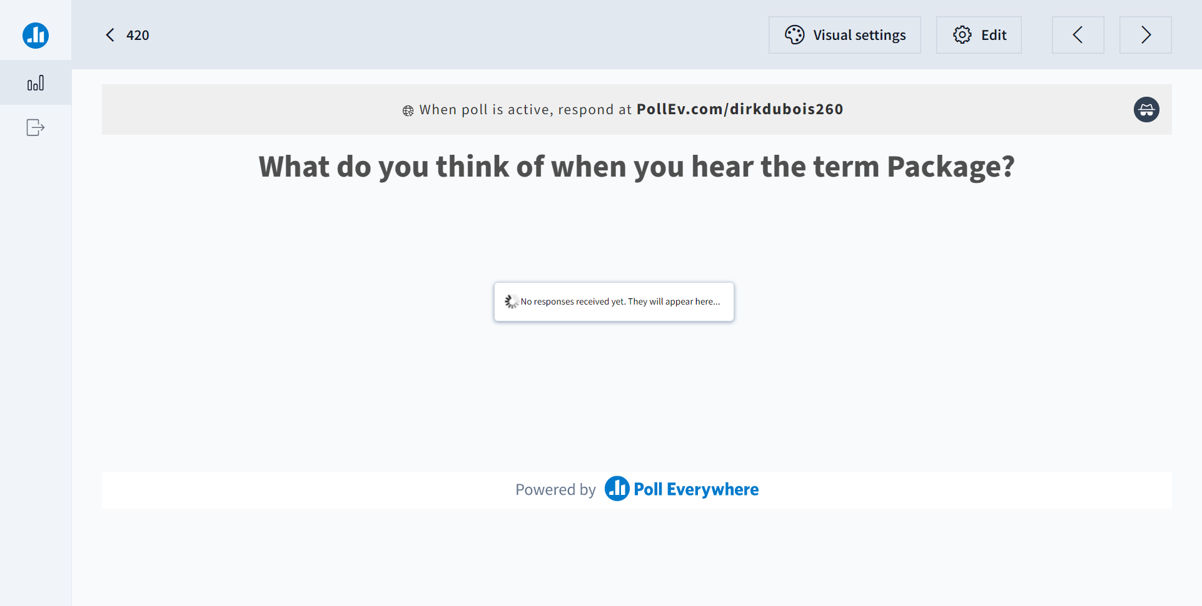

Slide 8

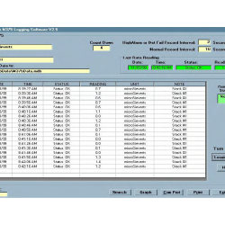
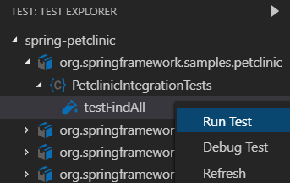
Python has amazing built-in libraries
XML parsers
Logging
Unit Testing

Slide 9
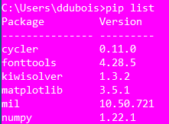
pip is a built-in package manager
Connects to the internet to fetch packages
Uses the Python Package Index (PyPi)
Handles dependencies between packages
Handles updating version and different OS and bitness
Used by users to install external libraries

Slide 10
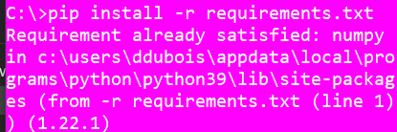
pip manages your installation
list tells you what packages were installed
install gets packages
uninstall removes them
Be careful, it doesn’t remove dependencies
We can use pip install –r requirements.txt to install a series of packages

Slide 11

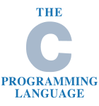
Not all python libraries are purely python
Pure Python
Partly written in C/C++

Slide 12


Code needs to be runnable on any system
Git
Python
Environment

Slide 13
Python uses virtual environments to isolate libraries and runtimes
Computers can have multiple versions of Python installed
Each Python version can have a different set of libraries installed
Virtual Environments copy both the python runtime and isolate the libraries
Versions
Libraries
venv, virtualenv, pipenv, etc

Slide 14
Virtual environments let us automate setup and deployment
Developer Setup
Isolate our libraries and their dependencies from other projects
Test Setup
Allows test machines to install required dependencies
Production Setup
Creates a repeatable way to install all the required dependencies
rem create dependency list
pip freeze > requirements.txt
rem install libraries using requirements.txt
pip install -r requirements.txt

Slide 15
There are many tool choices
Part of Python 3
Requires no extra install
Limited features
External package
Very popular
Additional features
Leverages other packaging standards
Useful for large systems
venv (built into Python 3)
Virtualenv (external package)
Pipenv (external package)

Slide 16
Functions
Optional & Positions arguments

Slide 17
Python functions can return multiple values
def keyword defines a function
Can take parameters (optional)
If parameters are defined, they must be passed
Can return a value or values (optional)
def swap(a, b):
return b, a
if __name__ == '__main__':
a = swap(1, 2)
print(a) # (2, 1)
print(type(a)) # Tuple
a, b = swap(1, 2)
print(a) # 2
print(b) # 1

Slide 18
Function invocation order is the same as Java
Values passed to parameters are resolved first
Only concrete values are passed to the function through parameters
d, e = swap(add(1,2), 4)
print(f'{d}, {e}') # 4, 3

Slide 19
Functions can have optional parameters
Optional parameters must arrive after required parameters
A default value is provided to create an optional parameter
When invoking we can refer to the optional parameter by name
def sub(a, b, display=False):
c = a - b
if display:
print(c)
return c … c = sub(2,1) # Printing disabled
d = sub(3,1, True) # Printing enabled
e = sub(4,1, display=True) # Can specify by name

Slide 20
Functions can have a variable number of parameters
The * notation next to a parameter name allows for a variable number
Variable number parameters must be after required parameters
def add_scores(*scores):
sum = 0
for i in scores:
sum += i
return sum
…
sum = add_scores(1,2,3)
print(sum) # 6
sum = add_scores(1,2,3,4,5)
print(sum) # 15

Slide 21
Optional keywords is also possible
**kwargs is an optional set of keyword arguments
Creates a dictionary of keywords versus parameter values
Common in complex libraries, E.g., numpy
def phrase(**words):
for k, v in words.items():
print(v, end=' ‘)
…
phrase(subject="I", verb="am testing")
# I am testing

